Slide 1




Nonperiodic optical superlattice lithium niobite waveguides for the generation of polarization entanglement
Wen-Chiuan Su¹, Jasleen Lugani², Frank Setzpfandt², and Yen-Hung Chen¹
¹Department of Optics and Photonics, National Central University, Taiwan (R.O.C.)
²Institute of Applied Physics, Friedrich-Schiller-University Jena, Germany
Acknowledgement
This work was supported by the Ministry of Science and Technology of Taiwan (MOST)
Notes:
Good afternoon everyone. I’m Wen-Chiuan Su from National Central University in Taiwan. Today I’m going to talk about ‘’.

Slide 2

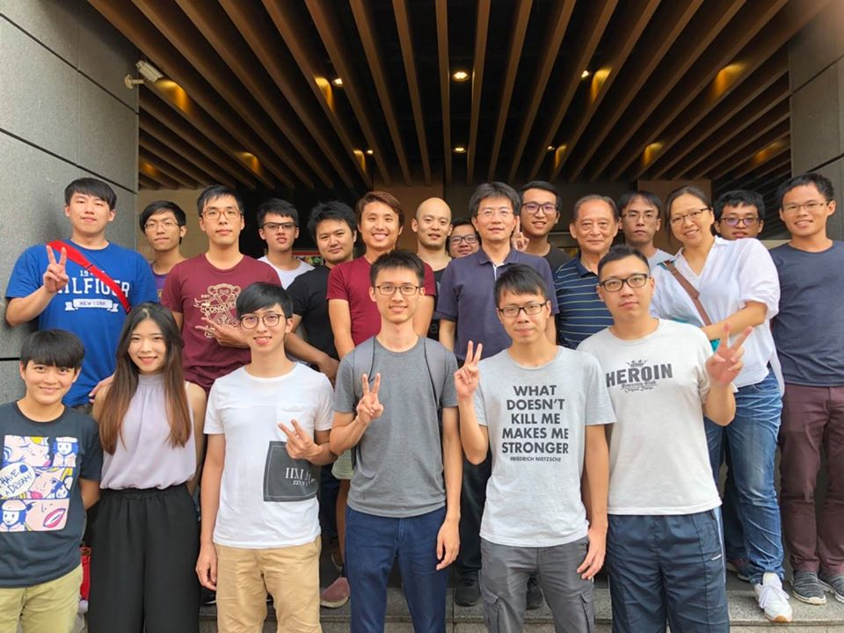
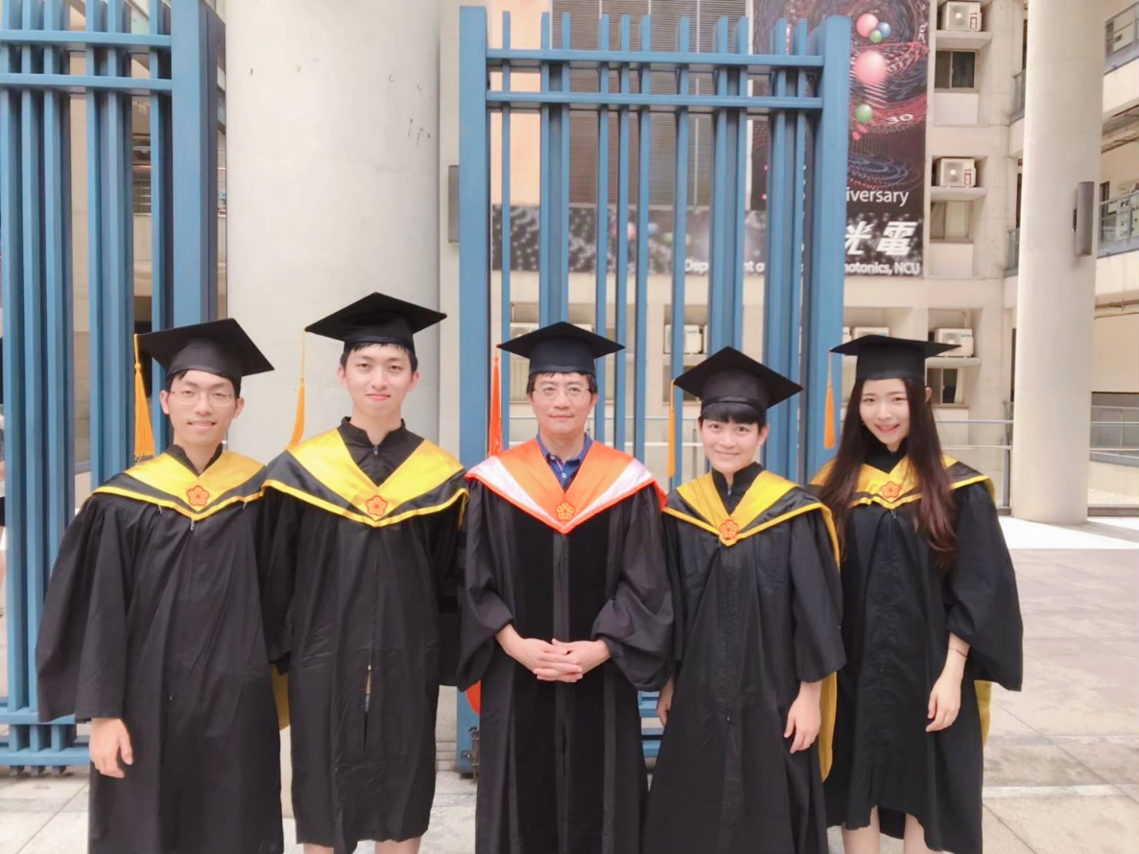
Outline
Introduction
Working Principle
Simulation
Fabrication
Results
Future Work & Summary
Notes:
Here’s the outline. I will talk about why and how we study this topic. Then give the results of simulation, fabrication and measurement.

Slide 3
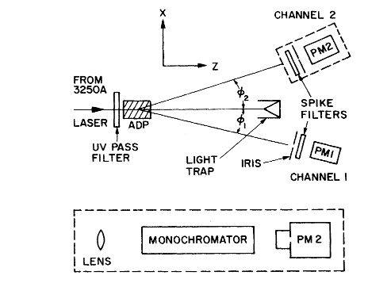
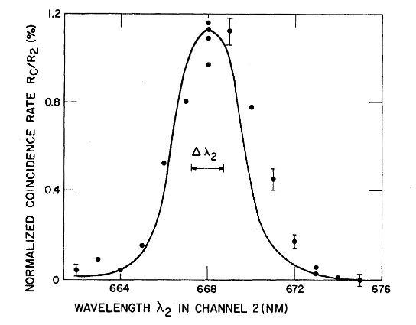
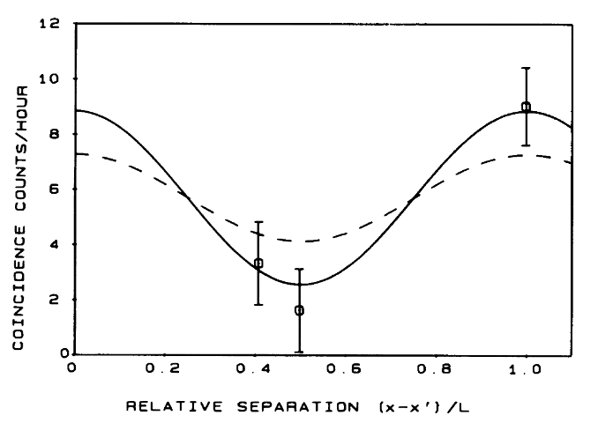
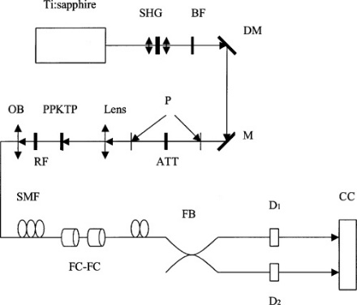
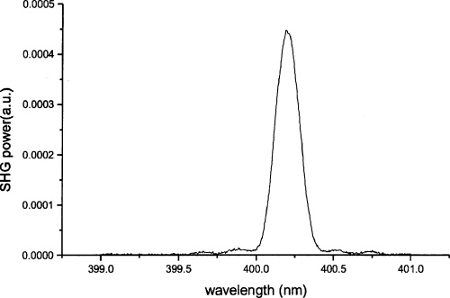
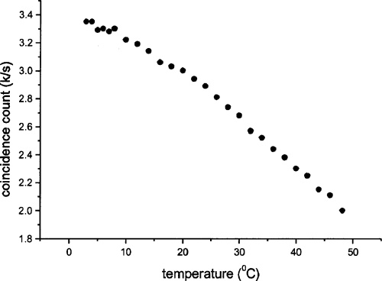
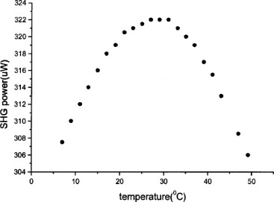
Introduction
Spontaneous Parametric Down-Conversion
SPDC with quantum phenomenon
Phys. Rev. Lett. 25 (2): 84. (1970).
Phys. Rev. Lett. 59 (17): 1903–1905. (1987).
SPDC in bulk PPKTP
Quantum information
Quantum cryptography
Quantum computation
etc.
J. Opt. Soc. Am. B 21, 2081-2084
Notes:
Let me now just focus on the periodically poled crystal using in SPDC process. In the beginning, many groups are using bulk crystal to generate photon pairs, such as KTP. Then people come up an idea of using waveguide to guide the light into a small area. That can make the efficiency much higher. Then people start to do the research of SPDC in LN waveguide because of some advantages.

Slide 4
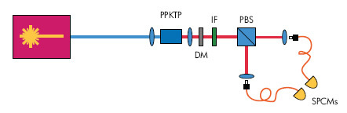
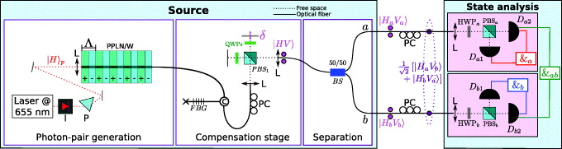
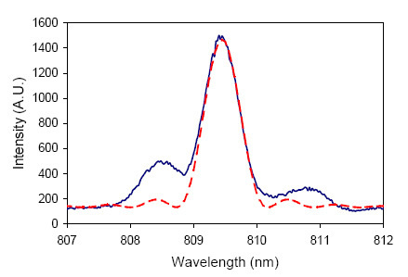
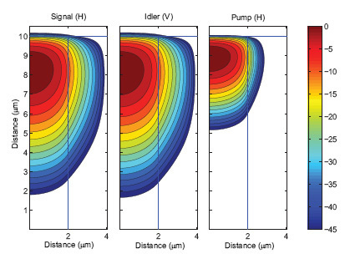
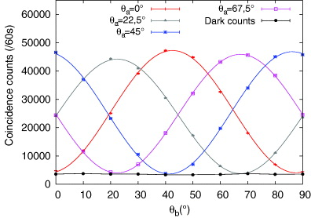
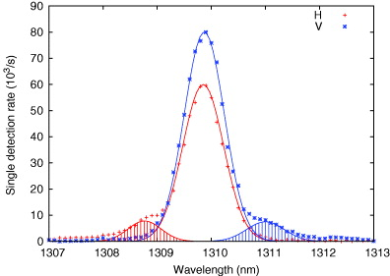
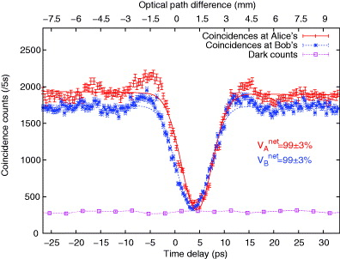
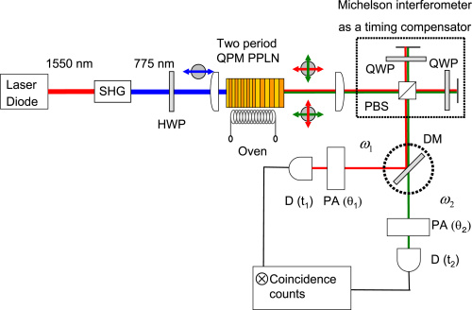
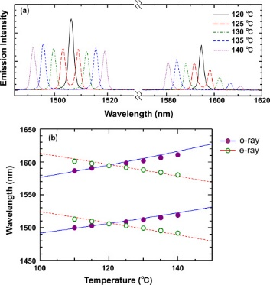
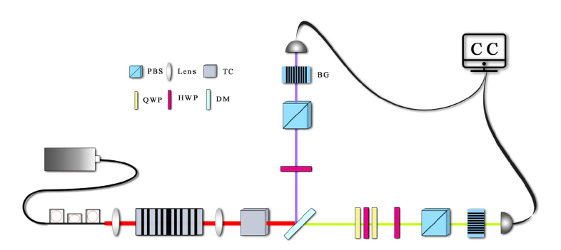
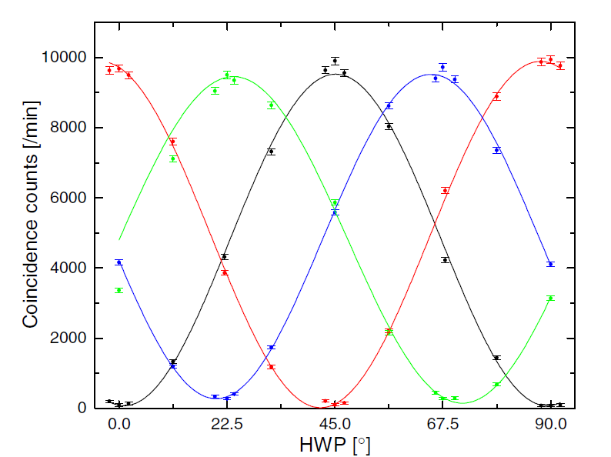
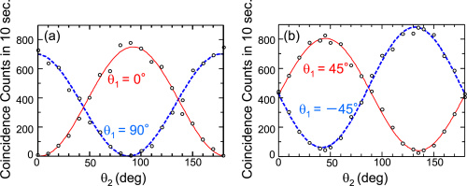
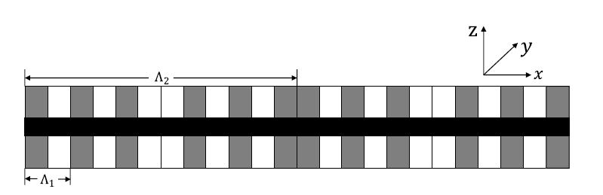
Introduction
SPDC in PPKTP waveguide
SPDC in PPLN waveguide
Opt. Express 15, 7479-7488 (2007)
New J. Phys. 12 103005
SPDC in cascade PPLN
SPDC in dual-periodically-poled structure
Opt. Express 20, 5508-5517 (2012)
Opt. Lett. 44(22), 5598–5601 (2019).
Notes:
Let me now just focus on the periodically poled crystal using in SPDC process. In the beginning, many groups are using bulk crystal to generate photon pairs, such as KTP. Then people come up an idea of using waveguide to guide the light into a small area. That can make the efficiency much higher. Then people start to do the research of SPDC in LN waveguide because of some advantages.

Slide 5
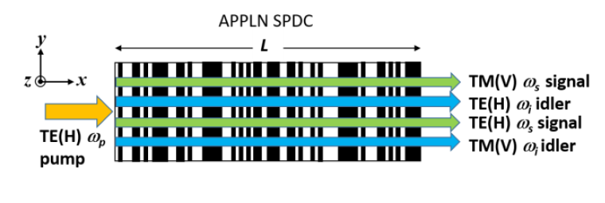
Introduction
In this study
Advantages
Pump wavelength = 780 nm, TE
Signal wavelength = 1550 nm, TE & TM
Idler wavelength = 1570 nm, TM & TE
Compact
Designable multiple photon pairs
Eliminate time delay
Notes:
Let me now just focus on the periodically poled crystal using in SPDC process. In the beginning, many groups are using bulk crystal to generate photon pairs, such as KTP. Then people come up an idea of using waveguide to guide the light into a small area. That can make the efficiency much higher. Then people start to do the research of SPDC in LN waveguide because of some advantages.

Slide 6









Working Principle
Sum Frequency Generation (SFG)
ω₁
Χ⁽²⁾ crystal
ω₂
ω₃
Energy Conservation
Momentum Conservation (Quasi Phase Matching)
$$ω_{1}+ω_{1}=ω_{3}$$
$$k_{1}+k_{2}+k_{Λ}=k_{3}$$
$$k_{1}$$
$$k_{2}$$
$$k_{Λ}$$
$$ω_{1}$$
$$ω_{3}$$
$$ω_{2}$$
$$k_{3}$$

Slide 7








Working Principle
Spontaneous Parametric Down Conversion (SPDC)
ω_{s}
與OPG(Optical parametric generation)的差異 : 操作能量的不同
Χ⁽²⁾ crystal
ω_{p}
ω_{i}
Energy Conservation
Momentum Conservation (Quasi Phase Matching)
$$ω_{p}=ω_{s}+ω_{i}$$
$$k_{p}=k_{s}+k_{i}+k_{Λ}$$
$$k_{s}$$
$$k_{i}$$
$$k_{Λ}$$
$$ω_{s}$$
$$ω_{p}$$
$$ω_{i}$$
$$k_{p}$$

Slide 8
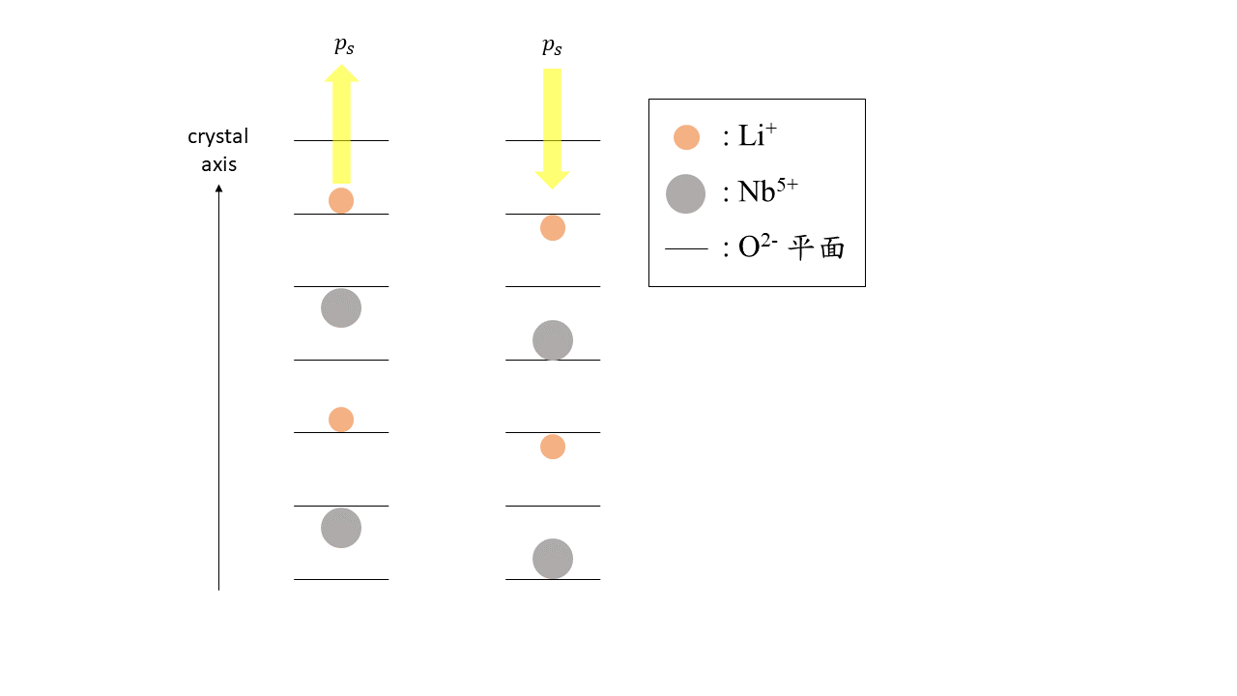


Working Principle
Aperiodically Poled Lithium Niobate (APPLN)
Λ
↑ | ↓ | ↑ | ↓ | ↑ | ↓ | ↑ | ↓ | ↑ | ↓ | ↑ | ↓ | ↑ | ↓ | ↑ | ↓ | ↑ | ↓ | ↑ | ↓
periodically poled
↑ | ↓ | ↑ | ↓ | ↑ | ↓ | ↑ | ↓ | ↑ | ↓ | ↑ | ↓ | ↑ | ↓
aperiodically poled
Potential energy
$$p_{s}$$
$$p_{s}$$
矯頑電場

Slide 9
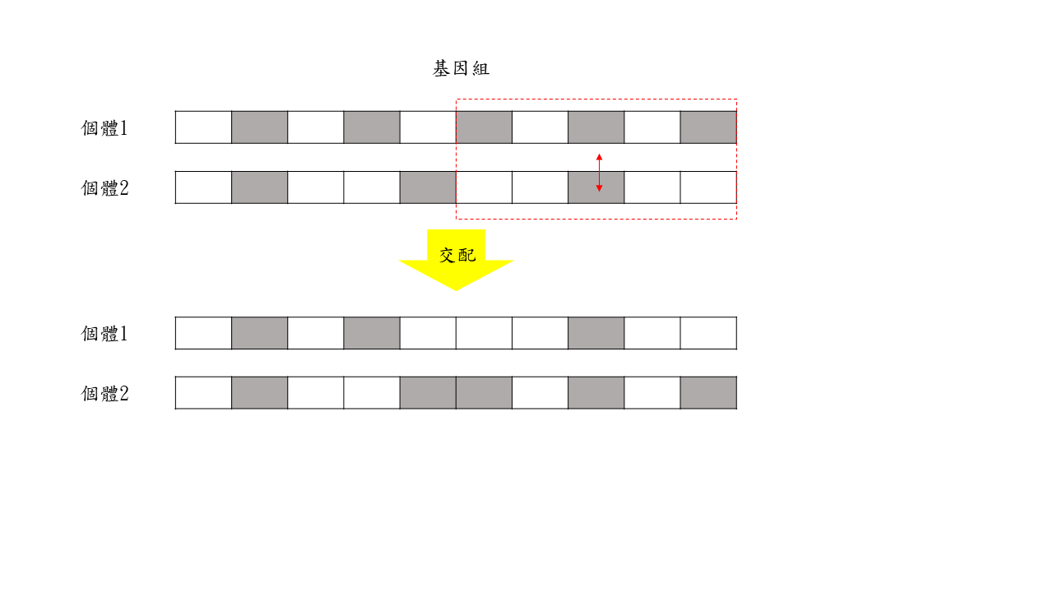
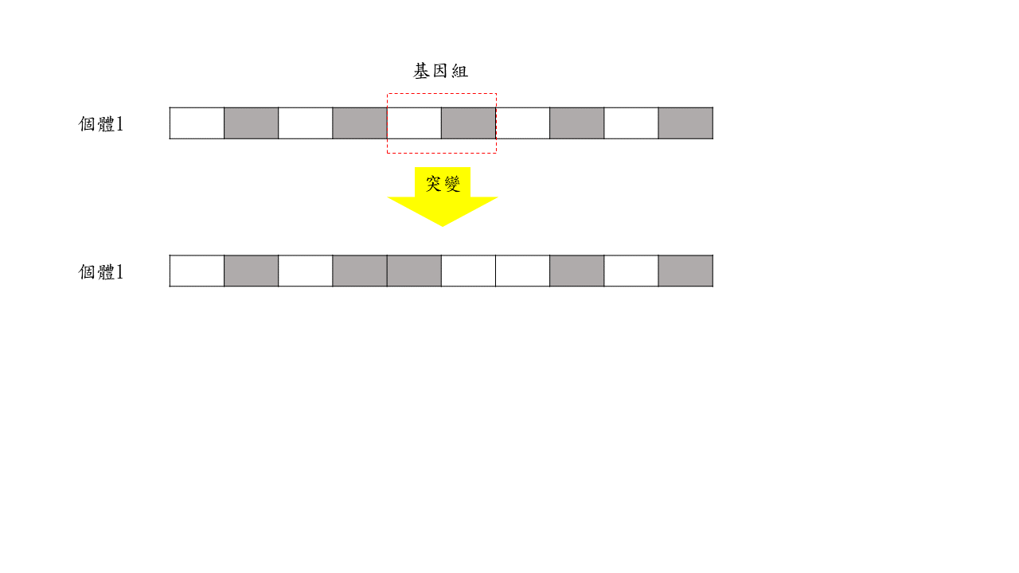
Working Principle
產生初始個體
Genetic Algorithm (GA)
計算適應度
是
達到最佳解
否
交配
結束
突變

Slide 10
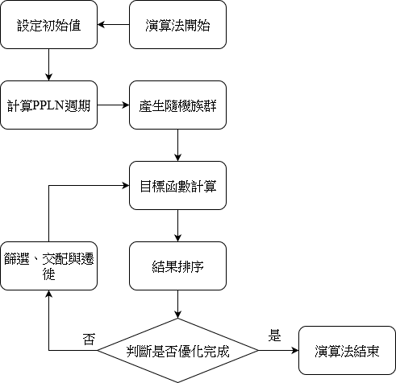
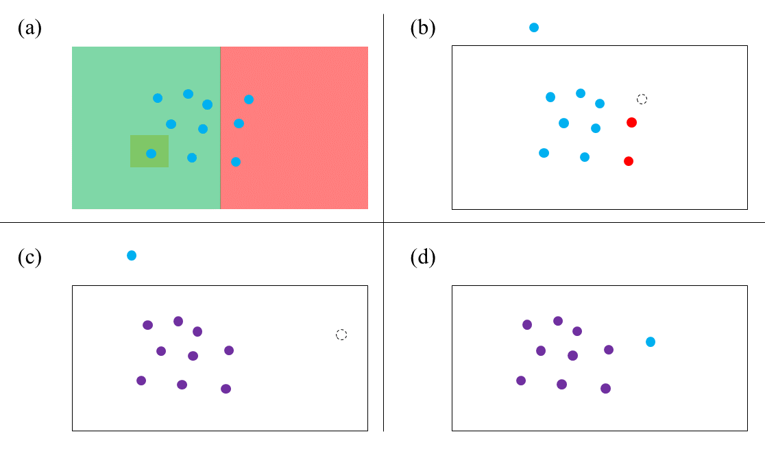
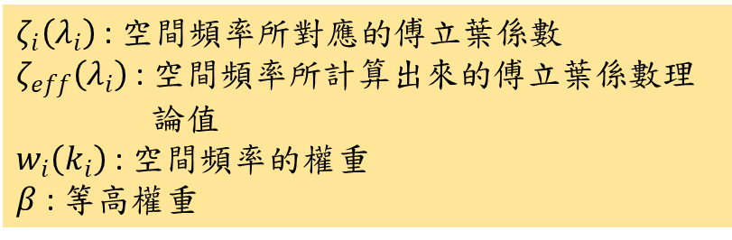
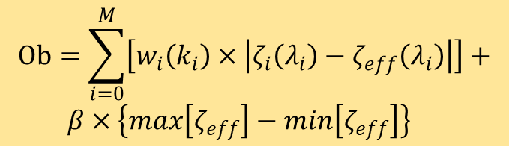


Simulation
Genetic Algorithm (GA)
$$k_{Λ_{1}}=k_{p_{o}}−k_{s_{e}}−k_{i_{o}}=9.65 μm$$
$$k_{Λ_{2}}=k_{p_{o}}−k_{s_{o}}−k_{i_{e}}=9.71 μm$$
$$Ob=\sum_{i=0}^{M}{\left[w_{i}\left(k_{i}\right)×\left|ζ_{i}\left(λ_{i}\right)−ζ_{eff}\left(λ_{i}\right)\right|\right]}+$$
$β×\left\{max\left[ζ_{eff}\right]−min\left[ζ_{eff}\right]\right\}$
$ζ_{i}\left(λ_{i}\right)$ : 空間頻率所對應的傅立葉係數
$ζ_{eff}\left(λ_{i}\right)$ : 空間頻率所計算出來的傅立葉係數理 論值
$w_{i}\left(k_{i}\right)$ : 空間頻率的權重
$β$ : 等高權重

Slide 11
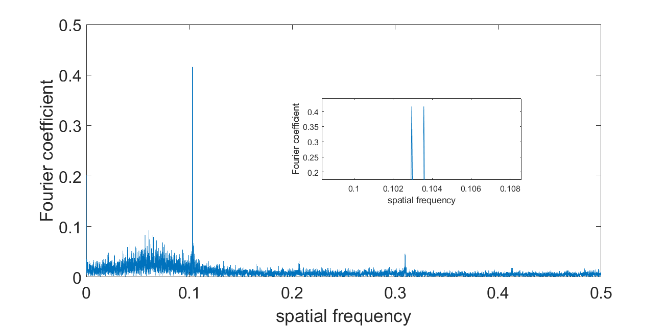
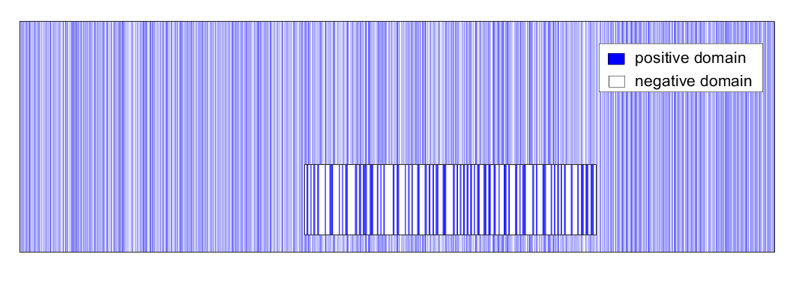
Simulation
Genetic Algorithm (GA)
9.71 μm
9.65 μm

Slide 12
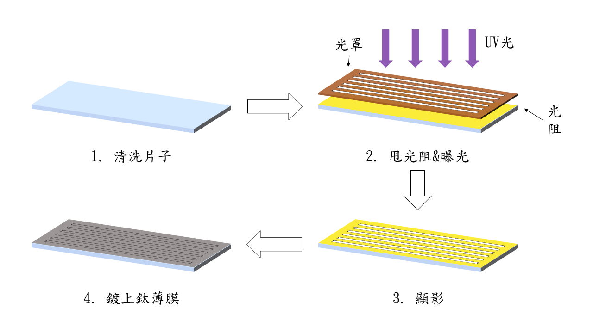
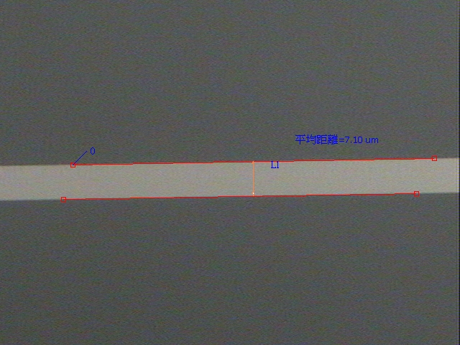
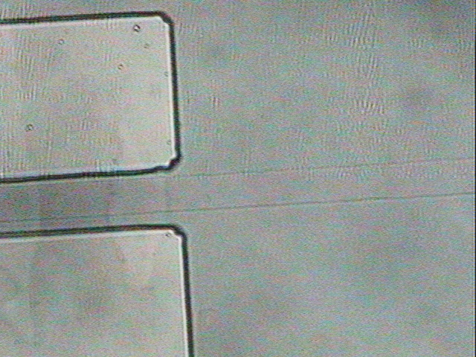
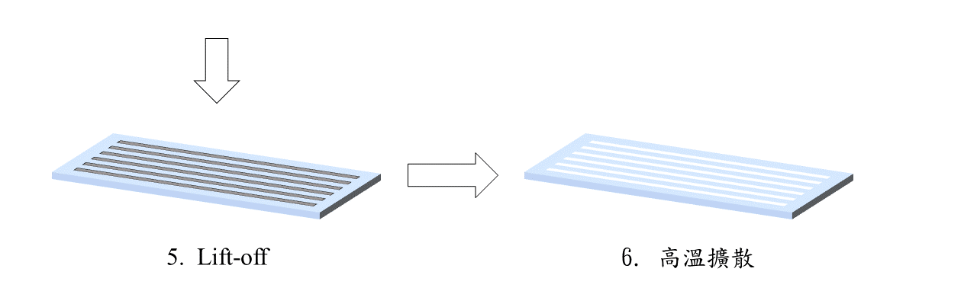
Fabrication
Waveguide Process
平均距離 = 7.10 μm

Slide 13
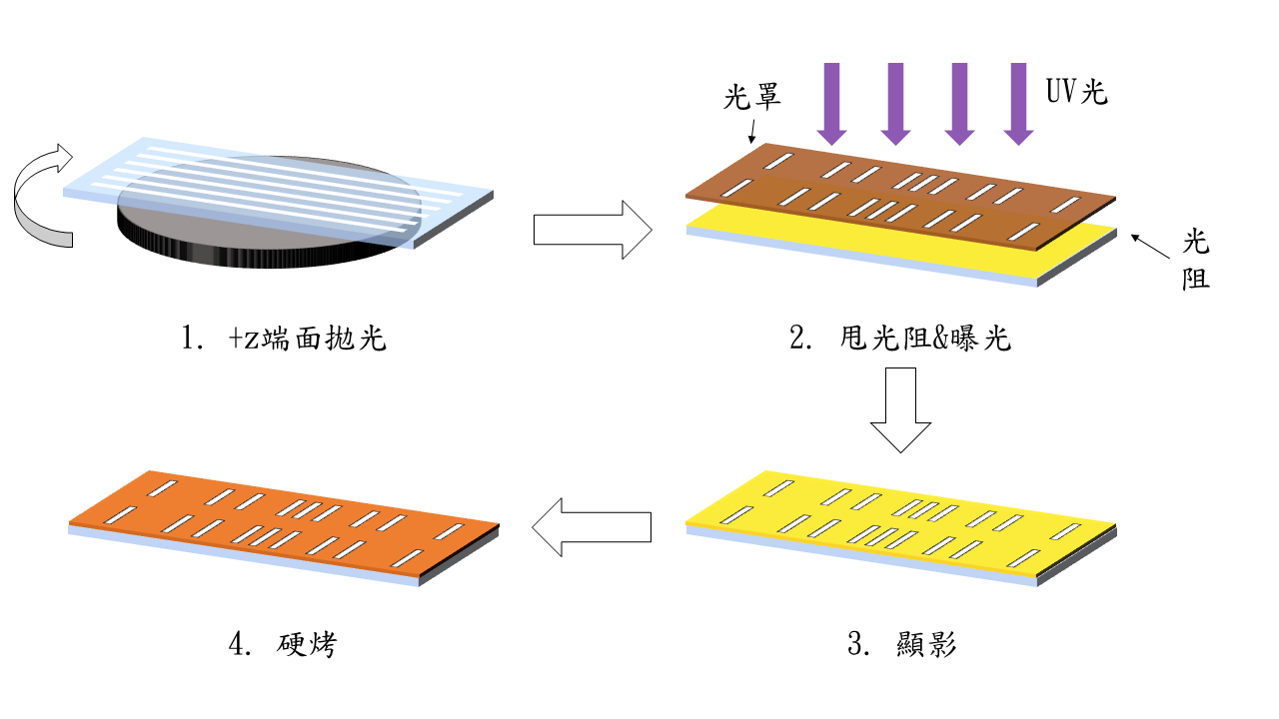
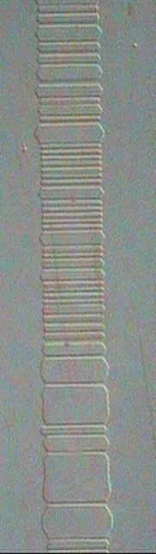
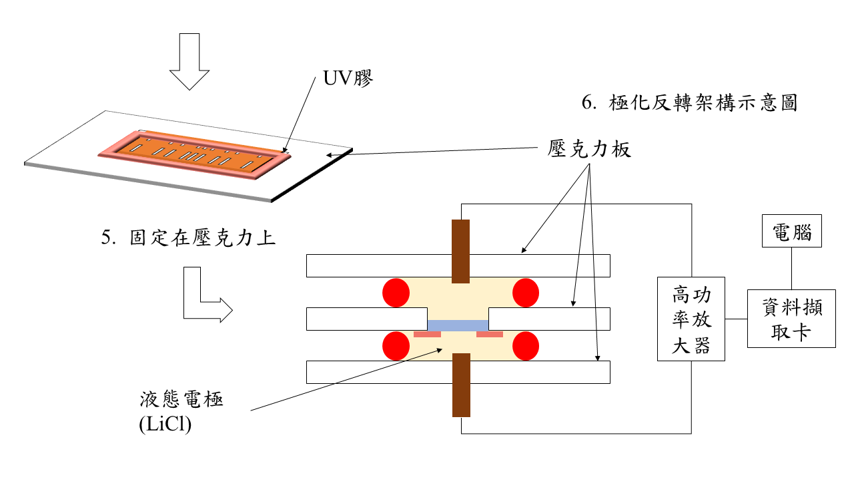
Fabrication
Poling Process

Slide 14
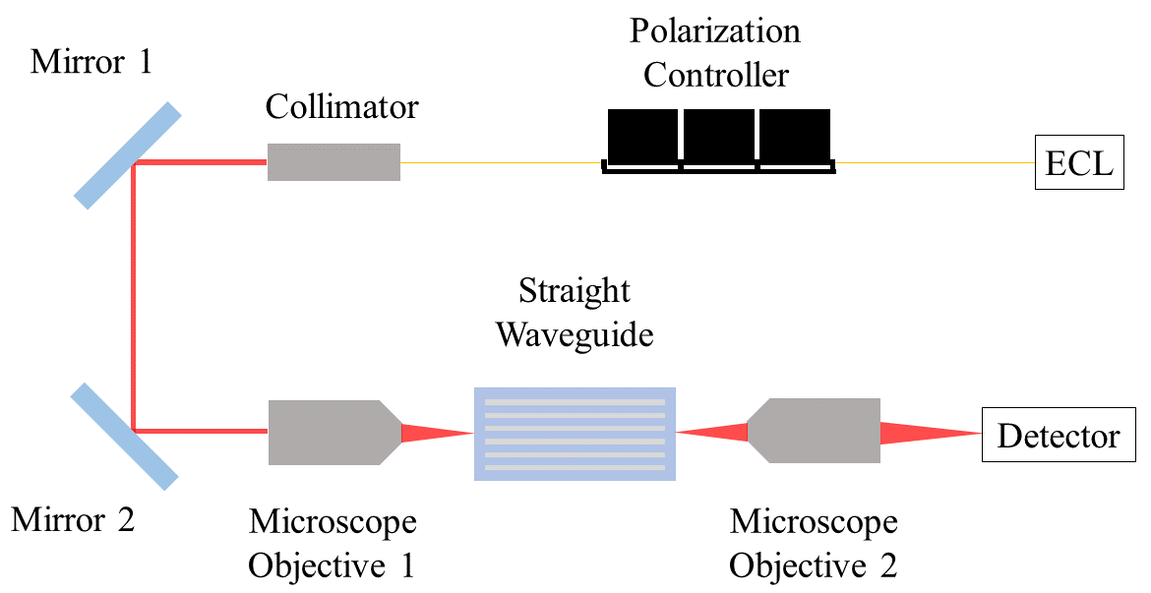
Results
Setup for Spatial Mode Experiment

Slide 15
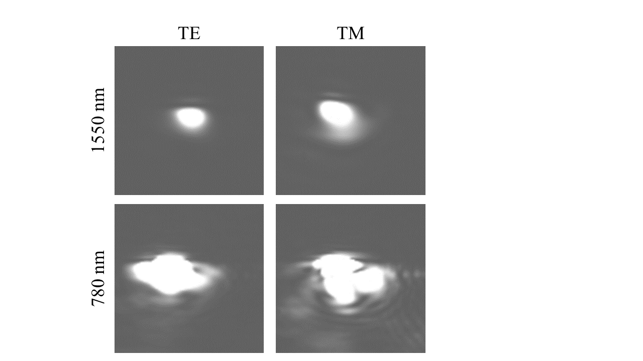
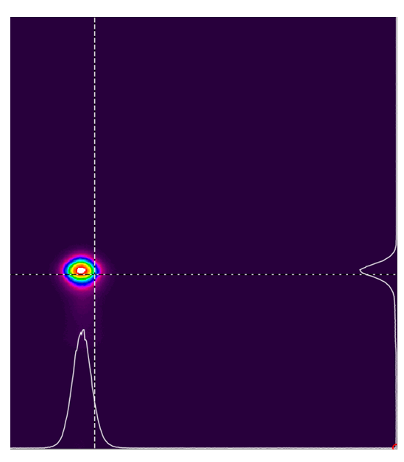
Results
Spatial mode
 | Δn(1550, TM) | Δn(1550, TE) | Depth(μm)
Measurement | 0.00527 | 0.00133 | 8.332
Simulation | 0.01136 | 0.00504

Slide 16
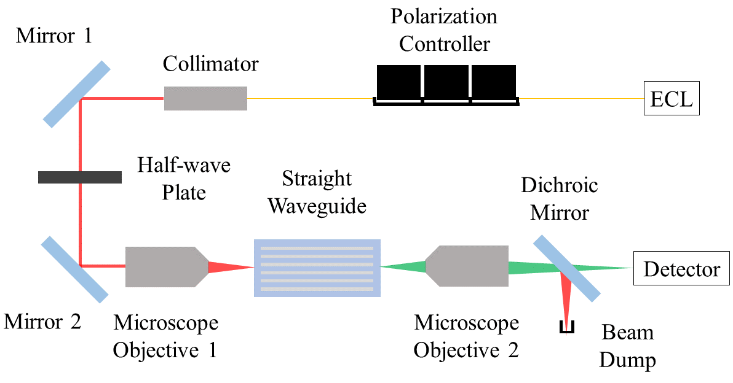
Results
Setup for SHG Experiment

Slide 17
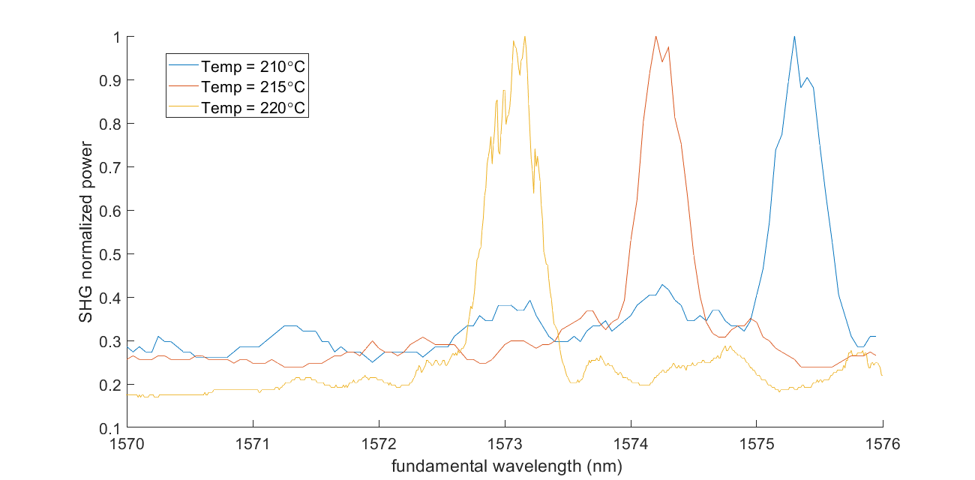
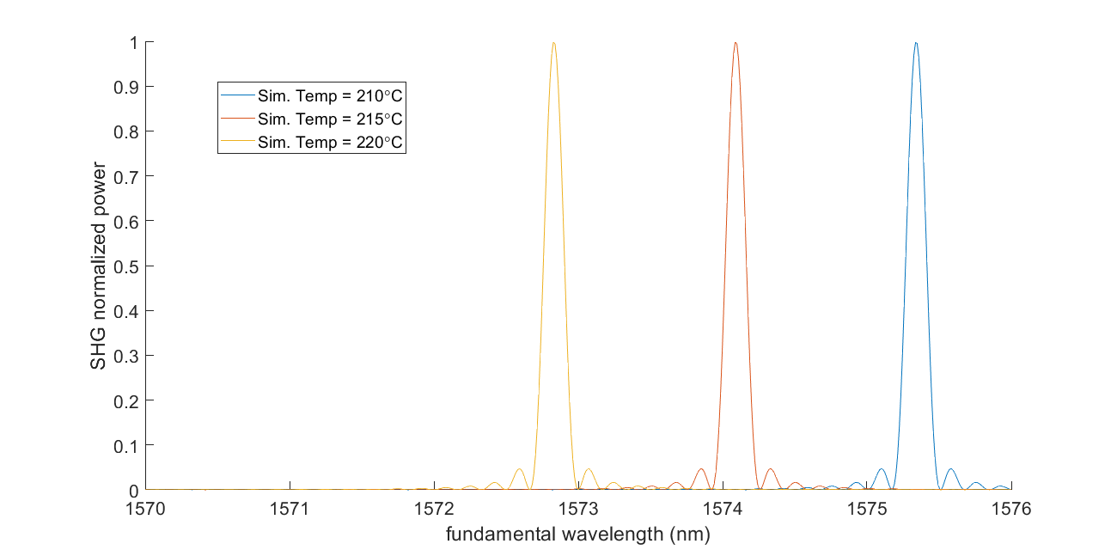
Results
Wavelength shifting
measurement : -0.23 nm/℃
simulation : -0.25 nm/℃
Varying Temperature

Slide 18
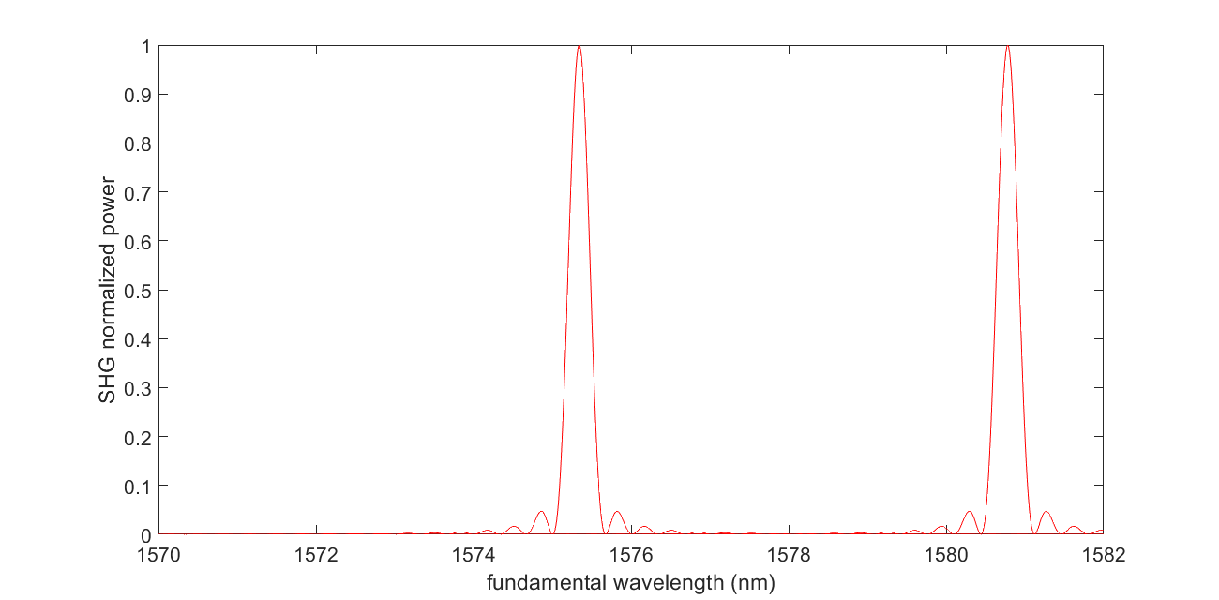
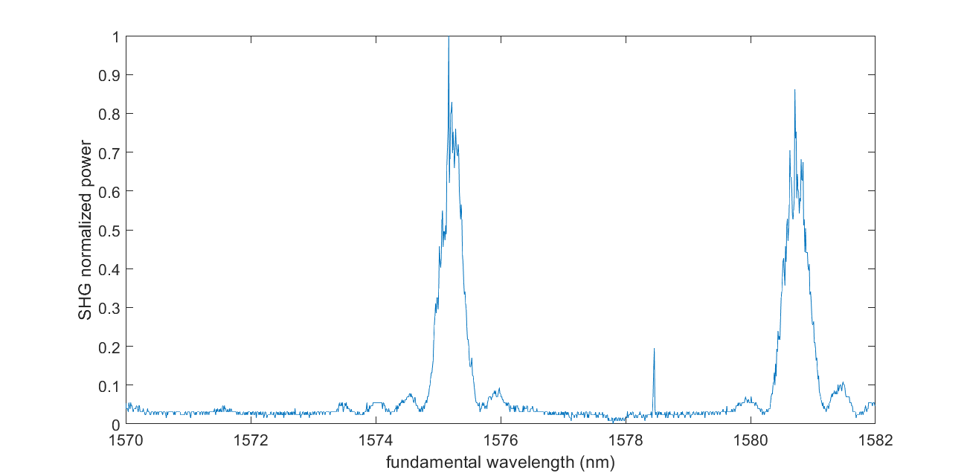
Results
Dual Peaks Measurement
Red line : simulation
Blue line : measurement
220℃
Peak differences
measurement : 5.6 nm
simulation : 4.4 nm
Peak wavelength : 1575.49 nm & 1580.94 nm

Slide 19
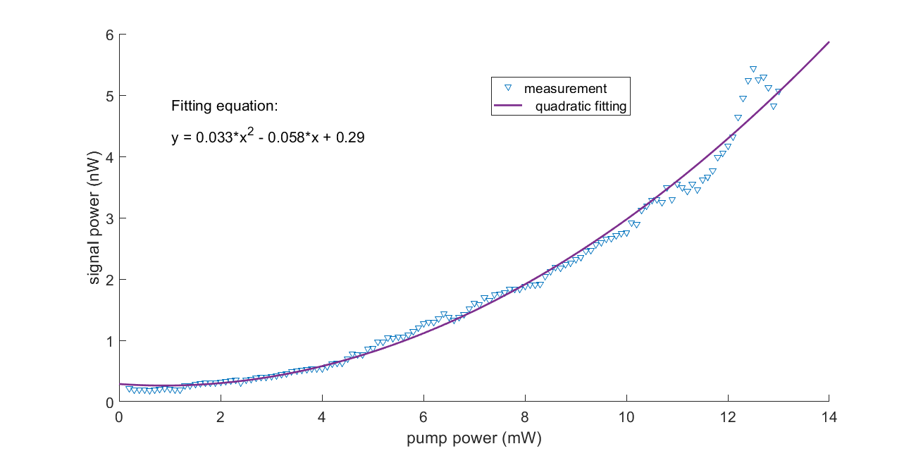
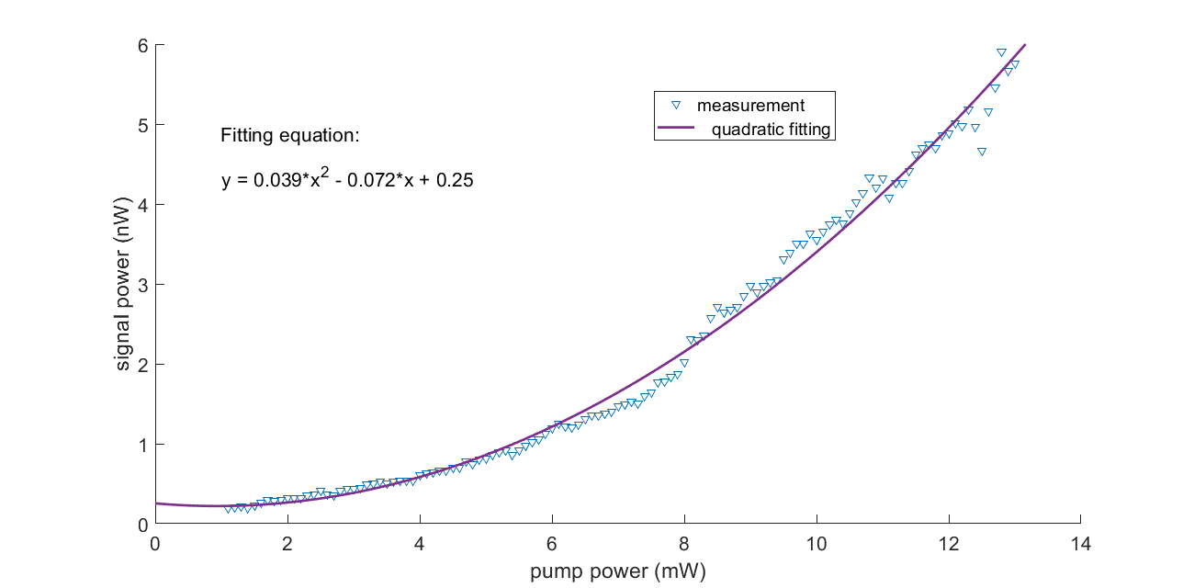
Results
Varying Pump Power
First Peak
Second Peak
λ=1580.94 nm
λ=1575.49 nm

Slide 20
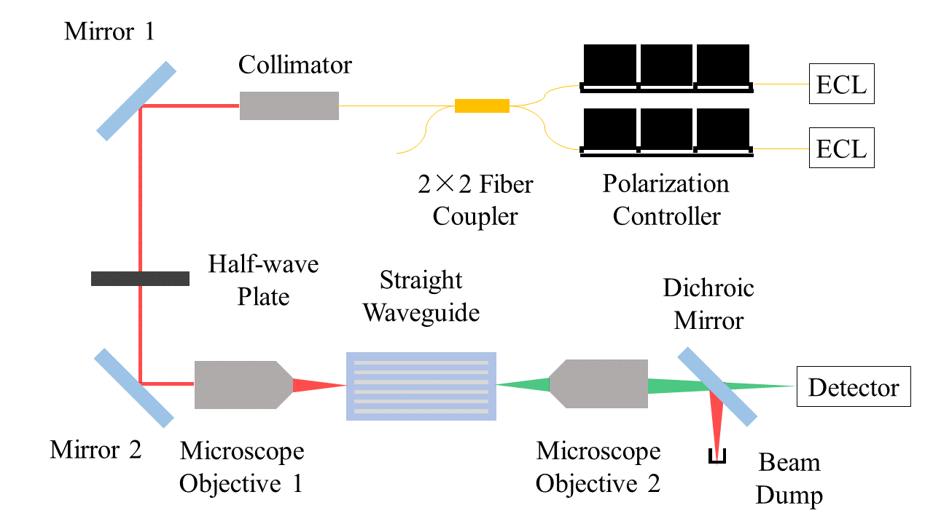
Results
Setup for SFG Experiment

Slide 21

Results
Setup for SFG Experiment
chip

Slide 22



Results
Sum Frequency Generation (SFG)
Measurement
(condition 1)
Measurement
(condition 2)
Λ₁
Λ₂
Λ₁
Λ₂
TE
TM
TM
TE

Slide 23


Results
Sum Frequency Generation (SFG)
Measurement (condition 3)
Simulation

Slide 24


Results
SFG to SPDC Reconstruction
Reconstruction
Simulation
Λ₁
Λ₂
TE
Λ₂
TM
Λ₁

Slide 25
Summary
Photons from different processes can be generated in an aperiodically poled structure.
Wavelength can be tuned by changing temperature.
Predict SPDC spectrum by reconstructing the SFG result.
First to generate multiple photon pairs by using an aperiodically poled structure.

Slide 26

Future Work
Problems
Solution
Time delay
Wavelength shifting
Electro-optic Polarization Mode Converter (EOPMC)
SPDC
Y-field
EOPMC
Z-field
electrode
累積的折射率差值
SPDC
Electro-optic Polarization Mode Converter
Time compensation
part
晶體長度
等長

Slide 27



Future Work
Electro-optic Polarization Mode Converter (EOPMC)
Electro-optic coefficient of LiNbO₃
$$r_{ij}=\left[\begin{aligned}&\begin{matrix}0 & {−r}_{22} & r_{13} \\ 0 & r_{22} & r_{13} \\ 0 & 0 & r_{33}\end{matrix} \\ &\begin{matrix}0 & r_{51} & 0 \\ r_{51} & 0 & 0 \\ r_{51} & 0 & 0\end{matrix}\end{aligned}\right]$$
Searcy, P., et al., Proceedings of SPIE - The International Society for Optical Engineering, 2010. 7672
applying electric field along Y direction
$$x^{2}\left(\frac{1}{n_{o}^{2}}−r_{22}E_{y}\right)+y^{2}\left(\frac{1}{n_{o}^{2}}+r_{22}E_{y}\right)+\frac{z^{2}}{n_{e}^{2}}+2yzr_{51}E_{y}=1$$

Slide 28

Future Work
Electro-optic Polarization Mode Converter (EOPMC)
Applied voltage = 100V
Bandwidth (T>99%) : 1.71 nm
Bandwidth (T>99%) : 1.58 nm

Slide 29



Slide 30
Thank you for your attention!
Nonlinear Integrated Laser Photonics Lab (NILP)

